Slide 1
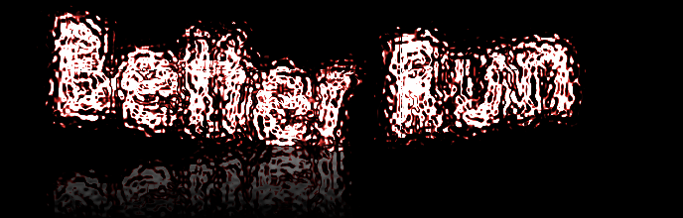
Based upon coding from developers of Pyrun
With coding attributed from Nakia Abdul and Benita Nzkeng

Slide 2
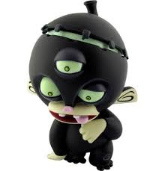
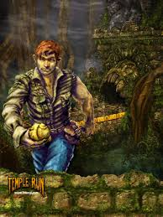
WHY?
Pyrun
The prupse of this project is to create a ”street” fighter version of temple run using the code from pyrun.
It allows for a new twist on temple run, a game so greatly enjoyed in the late 2011
Temple Run

Slide 3
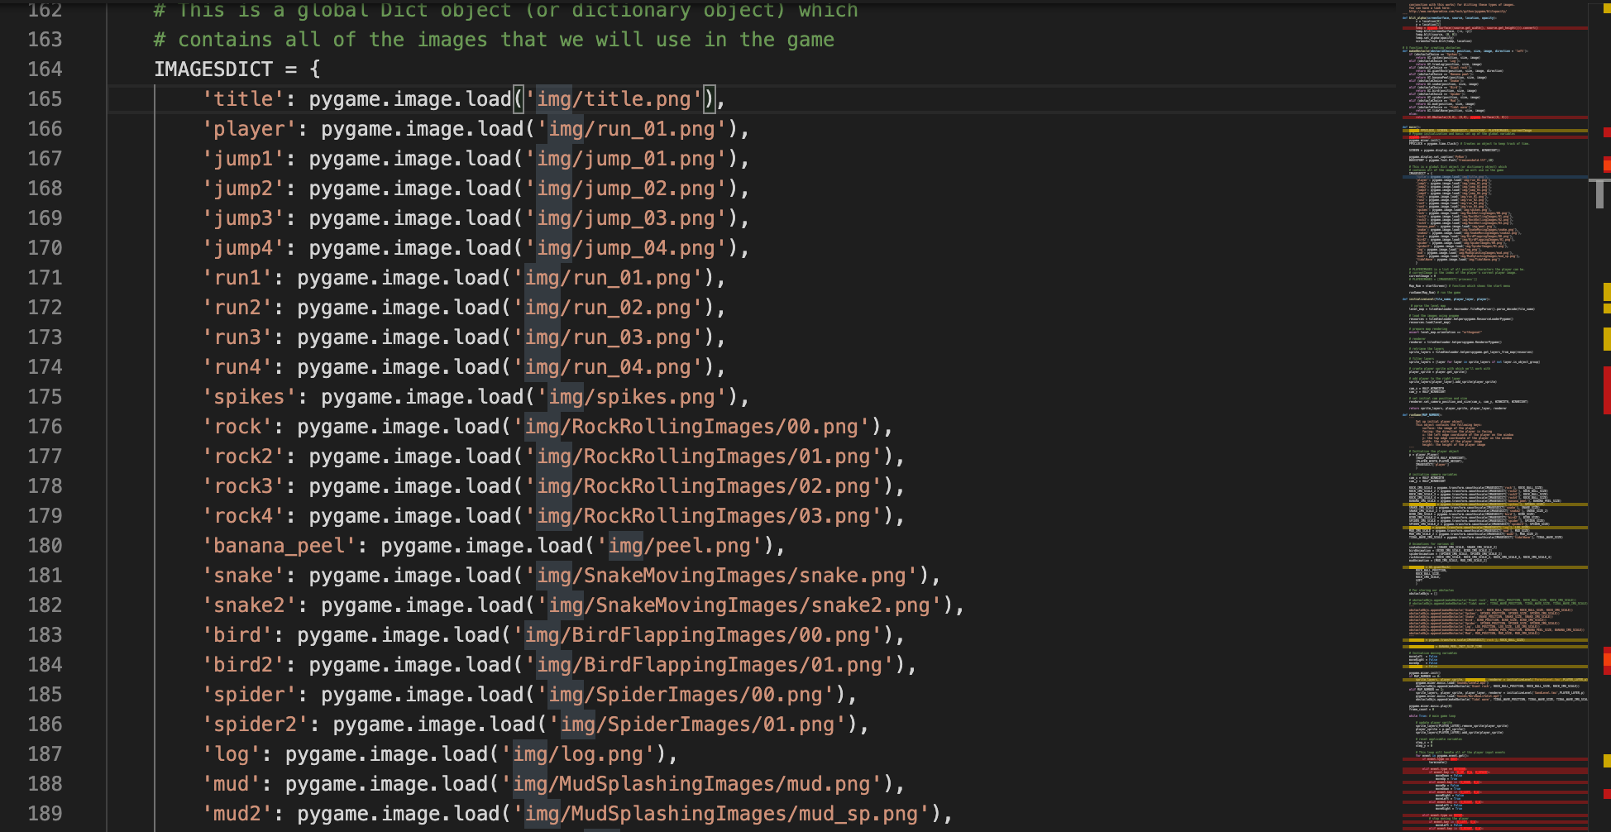
Example of Code:
Here is an example of some of the code.
After fixing majority of the issues(you'll be surprised how many) I am able to change the game to look how I want it to look including characters, villains, the ground and the sky.
https://github.com/ksu-is/Better-Run

